Slide 1


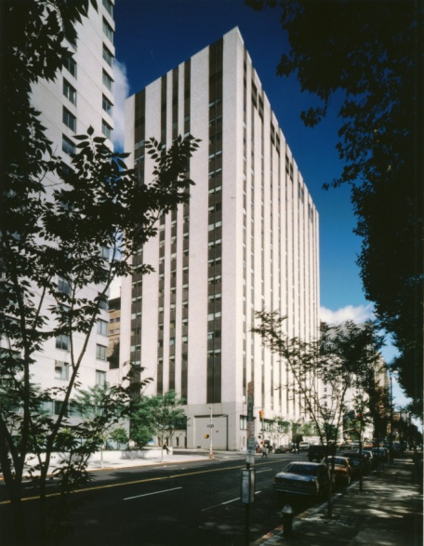
Retrospective Analysis of Antimicrobial Use and Bacterial Cultures in Hospitalized Cancer Patients with COVID-19
Kayla Maki, Pharm.D.¹; Samantha Steiger, Pharm.D., BCIDP¹; Susan Seo, MD²; Nina Cohen, Pharm.D., BCPS AQID¹
¹Department of Pharmacy, ²Department of Medicine, Infectious Diseases Service
Memorial Sloan Kettering Cancer Center, New York, NY
Background
Results
Results
In the era of COVID-19 concern for bacterial coinfections has resulted in widespread antimicrobial use. Sparse data are available on rates of bacterial coinfections and antimicrobial use in hospitalized immunocompromised patients with COVID-19 infection.
A review conducted by Rawson et al¹ to explore bacterial and fungal coinfections in patients admitted to the hospital with coronavirus lower respiratory tract infections, reported that 82 (8%) of 806 cases had bacterial or fungal coinfections. In the studies reviewed, a total of 1,450 (72%) of 2,010 patients received antibacterial therapy. In a meta-analysis conducted by Lansbury et al² evaluating co-infections in patients with COVID-19, 7% of hospitalized COVID-19 patients had bacterial co-infections. A higher proportion of ICU patients had bacterial co-infections than those in a mixed ward/ICU setting. The current available literature suggests that bacterial coinfections in patients with COVID-19 are relatively low, versus the high use of antimicrobials in these patients. However, there is still limited available investigating bacterial coinfections in the oncology population.
Due to the limited literature in the oncology population, the purpose of this retrospective study is to investigate antimicrobial use and positive bacterial cultures in admitted patients with COVID-19 at a tertiary cancer center.
375 patients were identified in the analysis , 358 were oncology patients
275 of 358 (77%) received antibiotics
76 of 358 (21%) patients had a positive bacterial culture result
Overall 30-day mortality occurred in 58/358 (16%) patients
Median LOS was 9.5 days (IQR 6, 18.8)
Median antibiotic LOT was 4 days (IQR 1, 8)
Table 2: Primary Outcomes
Clinical Parameters | N(%)
Transplant Palivizumab No Palivizumab Oncology Palivizumab No Palivizumab | 324 154 (48) 170 (52) 843 23 (3) 820 (97)
Table 1: Patient demographics (N=350?)
Characteristics | Mean (SD) | Range
Male | 103 (58) | 528 (53)
Age (years) | 7.4 (0.1-32) | 6 (0.1-53)
Diagnosis ALL AML Lymphoma Immunodeficiencies Neuroblastoma Sarcoma CNS tumors Other solid tumors Other hematologic malignancies | 60 (34) 34 (20) 8 (5) 64 (36) 2 (1) 0 2 (1) 4 (2) 3 (1) | 108 (11) 54 (5) 89 (9) 99 (10) 236 (24) 202 (20) 118 (12) 72 (8) 12 (1)
Table 3: Secondary Outcomes
Clinical Parameters | N (%)
Number of RSV Positive Swabs (%) Transplant Palivizumab No Palivizumab Oncology Palivizumab No Palivizumab | 282 (5.6%) 94 (4.6) 16 (0.8) 34 (1.1) 138 (4.7)
Hospitalization | 16 (5.7)
PICU Admission | 4 (1)
Objectives
Primary Objective
Evaluate the proportion of patients who received antibiotics and the proportion with positive bacterial cultures in patients with a positive COVID-19 polymerase chain reaction (PCR) result
Secondary Objectives
30-day mortality after a positive COVID-19 PCR result
Number of antibiotic days and length of therapy (LOT) after a positive COVID-19 PCR result
Length of stay (LOS) after a positive COVID-19 PCR result
Figure 1: 30-day Mortality
Conclusions and Future Directions
Conclusions
The majority of hospitalized cancer patients with COVID-19 received antimicrobials whereas a much smaller percentage had a positive bacterial culture, suggesting an opportunity to streamline or discontinue antibiotics in these patients. Identifying patients at high risk for bacterial coinfection are of high priority due to the risks of adverse effects and collateral damage associated with unnecessary antimicrobial use.
Future Directions
Design and evaluate targeted stewardship efforts to streamline or discontinue antibiotic therapy in cancer patients admitted to the hospital with COVID-19 or other respiratory viral infections.
Patients and Methods
Inclusion criteria:
All inpatients admitted to Memorial Sloan Kettering Cancer Center (MSKCC) with a positive COVID-19 PCR result between March 1, 2020 – June 15, 2020
Adults at least 18 years of age
Electronic medical records were used to collect information including antibiotic use, bacterial coinfections, 30-day mortality, hospital LOS, ICU LOS, oxygen supplementation, and need for invasive and non-invasive oxygen support
Descriptive statistics were utilized for data analysis
Institutional Review Board reviewed and approved this study
References
Rawson TM, Moore LP, Zhu N, et al. Bacterial and Fungal Coinfection in Individuals With Coronavirus: A Rapid Review To Support COVID-19 Antimicrobial Prescribing. Clinical Infectious Diseases. 2020:1-10.
Lansbury L, Lim B, Baskaran V, et al. Co-infections in people with COVID-19: a systematic review and meta-analysis. Journal of Infection. 2020;81:266-275.
Disclosure
All authors have nothing to disclose concerning possible financial or personal relationships with commercial entities that may have a direct or indirect interest in the subject matter of this presentation.
Notes:
Side margins are .65
Columns start at 5.1 vertical
Columns are 14 x 16.5
Intercolumn spacing is .6
Bottom gutter is .4
Blue is 7 120 179
Failed G-CSF Mobilization
Total number of prior apheresis (G-CSF only)
Total PBSC collection after agent #1 (106cells/kg)
Highest WBC (w/o plerixafor)
Plerixafor Mobilization
Duration (# of days) of cytopenia (WBC <0.5)
Days between last day of chemo and the start of plerixafor
Initial WBC (Labs before Plerixafor(WBC))
CT - Number of aphereses (for plerixafor)
PBSC??????
WBC peak (maybe) ?? Highest WBC before collection
Number of perixafor doses
CP - Total yield CD34+ cell count following plerixafor doses (x106/kg)
Time to CD34 peak (days)
Target is 10 * 10^6
Failure is 4 * 10^6

